Slide 1
Building Blocks [hash structures + signatures + coins]

Slide 2
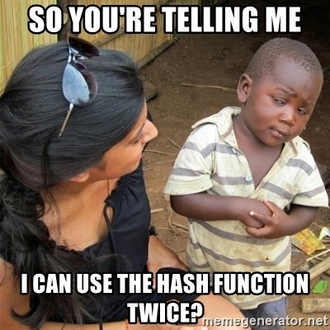
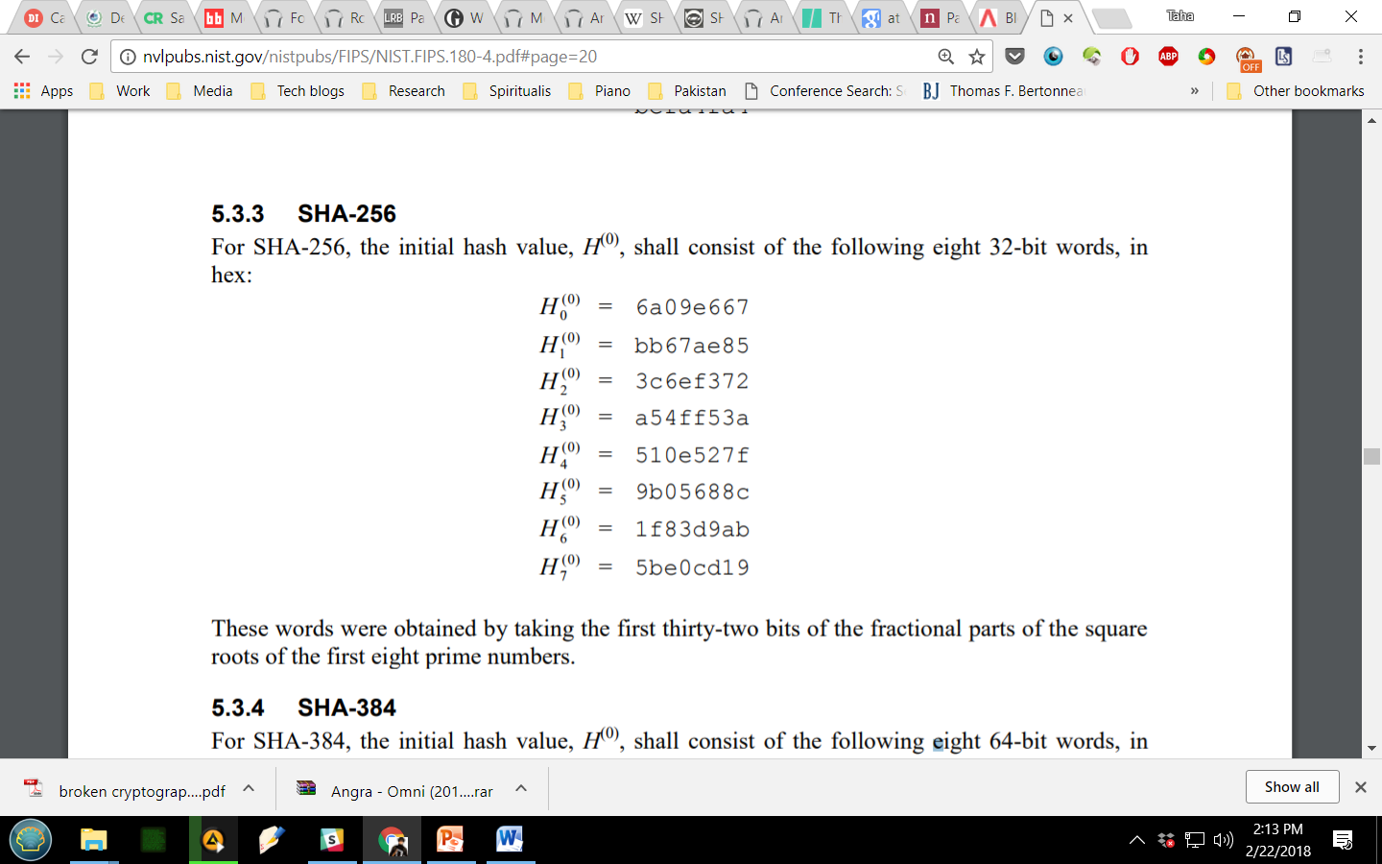
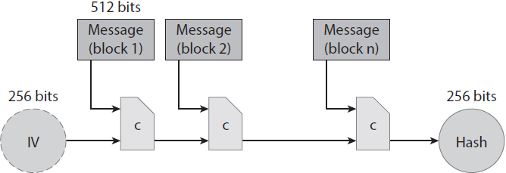
SHA-256
SHA2 family
compression function
fixed-length collision-resistant hash function
Merkle-Damgard transform
768-bit input - 512 bit block size, 256 bit output
Notes:
-the SHA-2 family consists of six hash functions with digests (hash values): SHA-224, SHA-256, SHA-384, SHA-512, SHA-512/224, SHA-512/256.
-the Merkle–Damgård construction was described in Ralph Merkle's Ph.D. thesis in 1979. Ralph Merkle and Ivan Damgård independently proved that the structure is sound: that is, if an appropriate padding scheme is used and the compression function is collision-resistant, then the hash function will also be collision-resistant.
A hash function must be able to process an arbitrary-length message into a fixed-length output. This can be achieved by breaking the input up into a series of equal-sized blocks, and operating on them in sequence using a one-way compression function.
-IV is reused for every call of the hash function
-IV value: http://nvlpubs.nist.gov/nistpubs/FIPS/NIST.FIPS.180-4.pdf#page=20

Slide 3
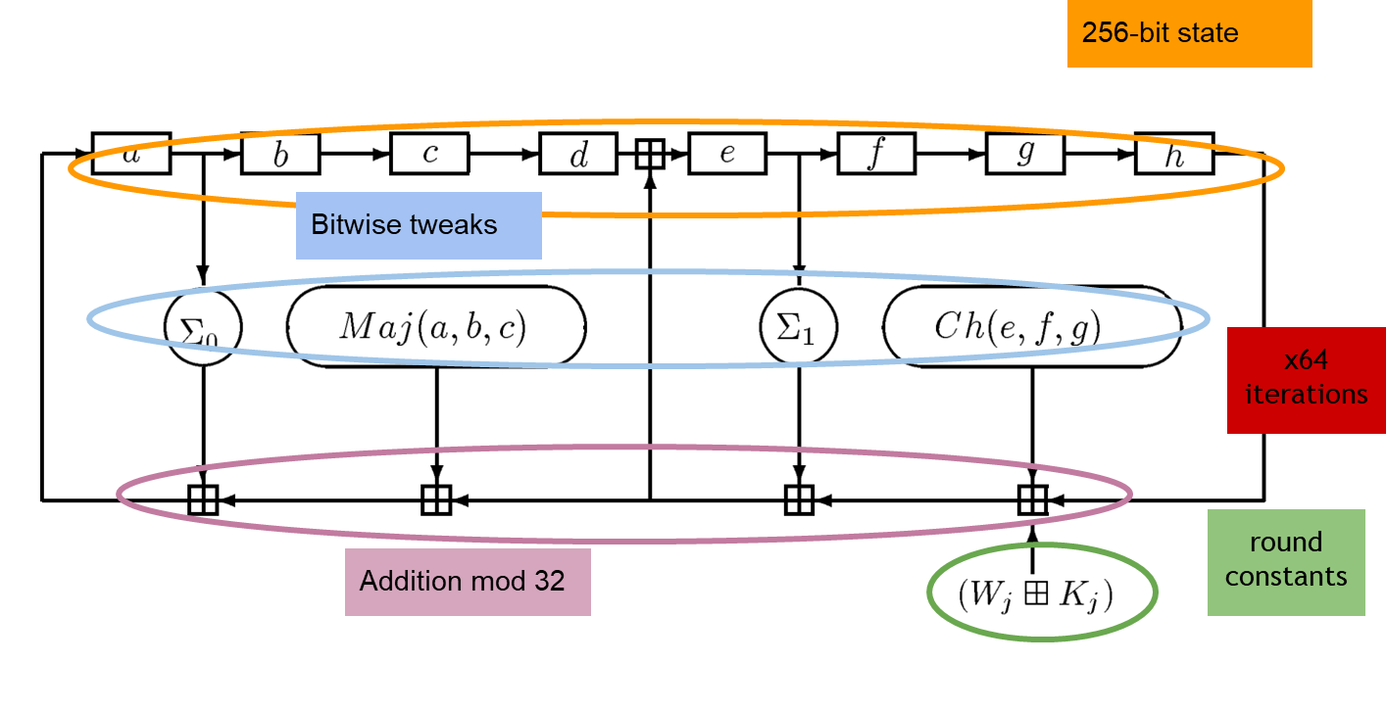
SHA-256
for miners!
manipulate 32 bit words
32 bit modular addition
bitwise logic
Notes:
-8 32-bit words (highly optimized for 32 bit hardware)
-small bitwise tweaks applied
-in each round a number of words are taken and added together (mod32)
-entire state is then shifted right
-inspired by design of linear feedback shift registers
-64 rounds (1 round in figure)
-different constants in each round (no two iterations are same!)
Maj and Ch functions - https://crypto.stackexchange.com/questions/5358/what-does-maj-and-ch-mean-in-sha-256-algorithm
Right rotation: https://crypto.stackexchange.com/questions/26215/rationale-for-use-of-right-shift-rather-than-rotate-in-sha-2

Slide 4

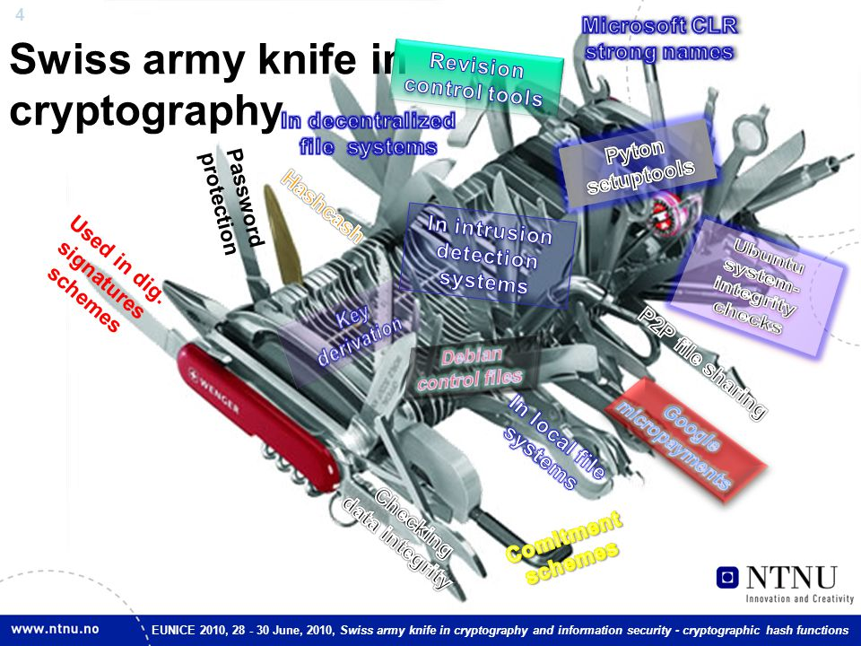
Hash functions utility
Swiss Army knife of cryptography
Notes:
-random oracle model – idealistic model of hash functions as functions that output an independent random variable for every possible input

Slide 5
Hash pointers
pointer
hash pointer = address + fingerprint
H(data)
data
retrieve information (address)
verify integrity
data structures using pointers?
Notes:
-data structures using pointers – lists, queues, trees, tables

Slide 6
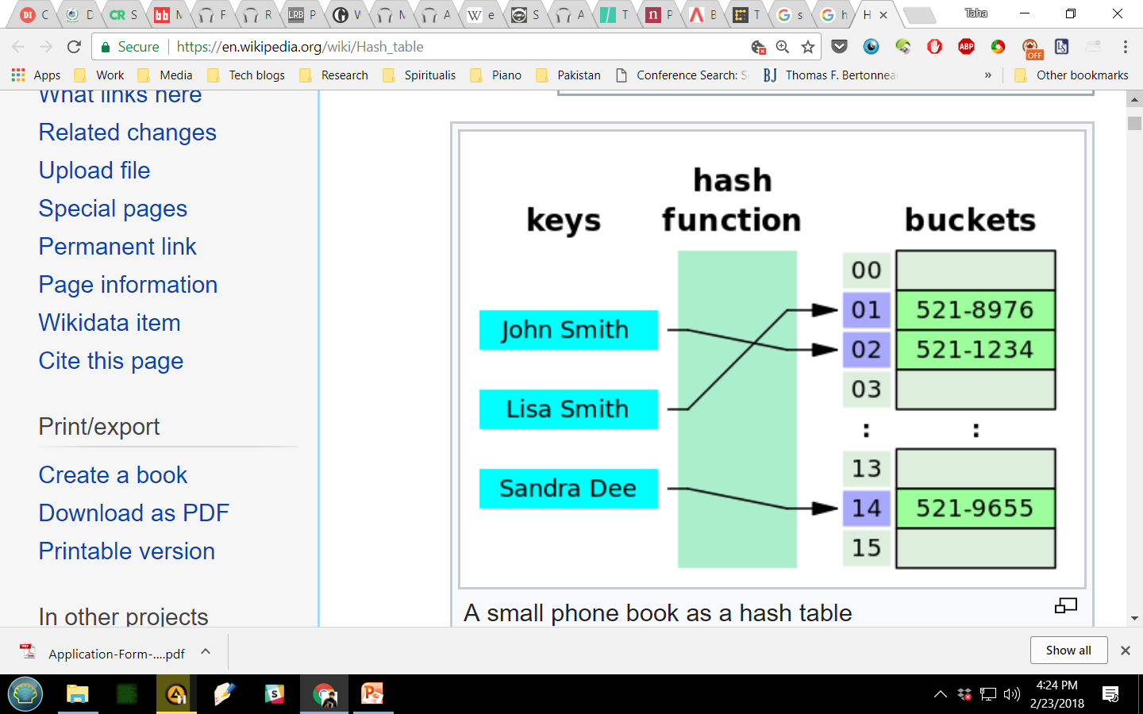
Hash tables
maps keys to values
phone directory
Notes:
-integrity property – if original value is stored in buckets!

Slide 7
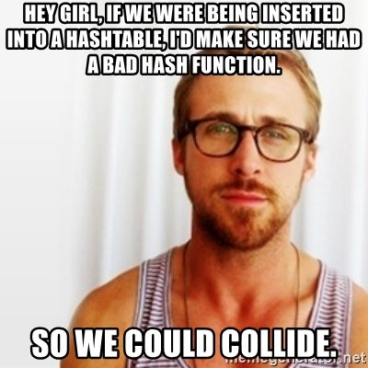
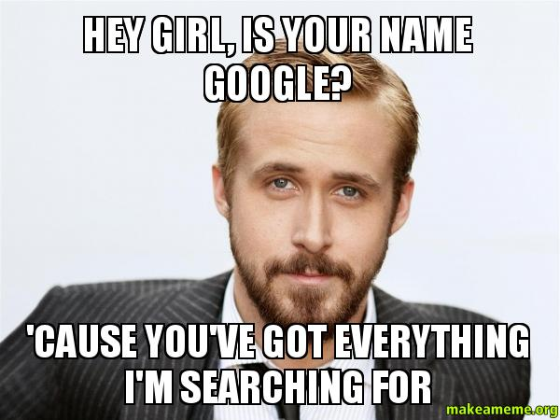
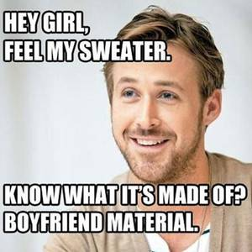
humor

Slide 8
Block chain
linked list
prev: address
prev: address
prev: address
data
data
data
block chain
prev: H(…)
prev: H(…)
prev: H(…)
data
data
data
Notes:
-each block tells us location of previous block
-also allows us to verify that the previous block has not been tampered with!
-block chain vs. blockchain

Slide 9
Block chain
application: tamper-evident log
prev: H(…)
prev: H(…)
H(…)
data
data
user retains only final hash pointer
adversary tampers with data in block k
inconsistency in block k+1
whole log protected by single hash value
block chain vs. basic hashing
Notes:
-tampering with every progressive block will finally lead to final hash pointer – which is in user’s possession
-this construction is very similar to the Merkle Damgard construction from earlier – same intuition behind them
-chaining effect protects entire log as opposed to individual blocks
-tampering effect will propagate throughout log
-even a minor change will *completely* change the blockchain

Slide 10
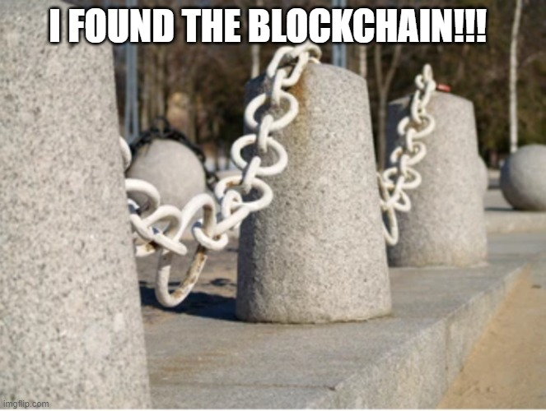
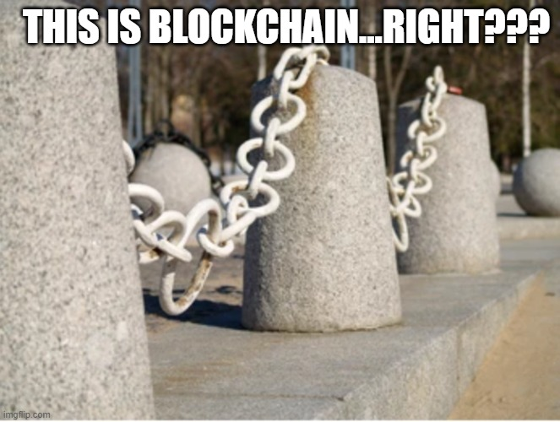
Block chain

Slide 11
Merkle trees
binary tree with hash pointers
Root
Hash (1)
Hash (2)
Hash (1)
Hash (2)
Hash (3)
Hash (4)
Hash (1)
Hash (2)
Hash (3)
Hash (4)
Hash (5)
Hash (6)
Hash (7)
Hash (8)
Data (1)
Data (2)
Data (3)
Data (4)
Data (5)
Data (6)
Data (7)
Data (8)
Notes:
-vertical dimension vs. horizontal dimension – serial vs. parallel hashing
-if tampering is done, will effect propagate all the way to the root?

Slide 12
Merkle trees
Root
tamper evident log?
proof of membership
Hash (1)
Hash (2)
Hash (1)
Hash (2)
Hash (1)
Hash (2)
log(n) items compute/reveal/store
advantage of privacy
Data (1)
Notes:
-how is proof of membership different for hash tree vs. block chain – whole chain required in latter case

Slide 13
Digital signatures
digital analog to handwritten signature
publicly verifiable
binding to data
unforgeable
non-repudiable
randomization
message size
sign message hash
Notes:
-link between unforgeable and non-repudiable?
-isValid is a boolean value indicating true (i.e. sig is valid) or false
-generateKeys is a randomized algorithm
-verify is always deterministic

Slide 14
Digital signatures
ECDSA
randomness (key, signature)
private key – 256 bits
public key – 512, 257 bits
message size – 256 bits
signature – 512 bits
Notes:
-signing hash pointer, signature then protects the whole structure, i.e. signing pointer at end of block chain effectively signs the whole blockchain

Slide 15
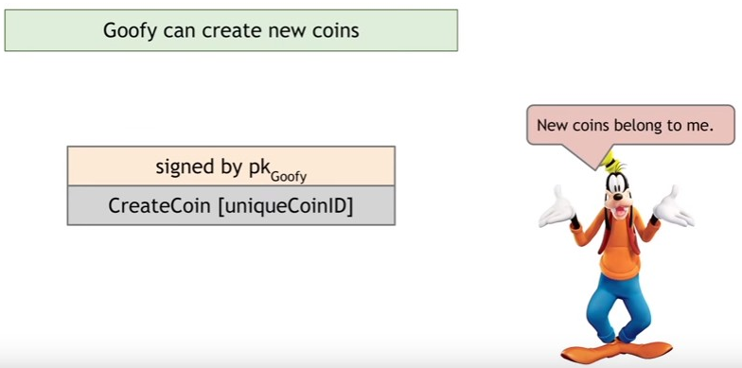
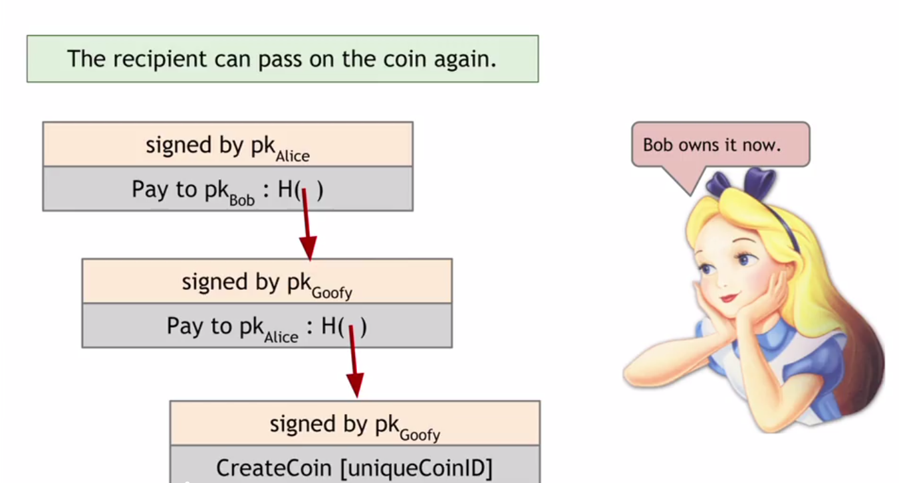
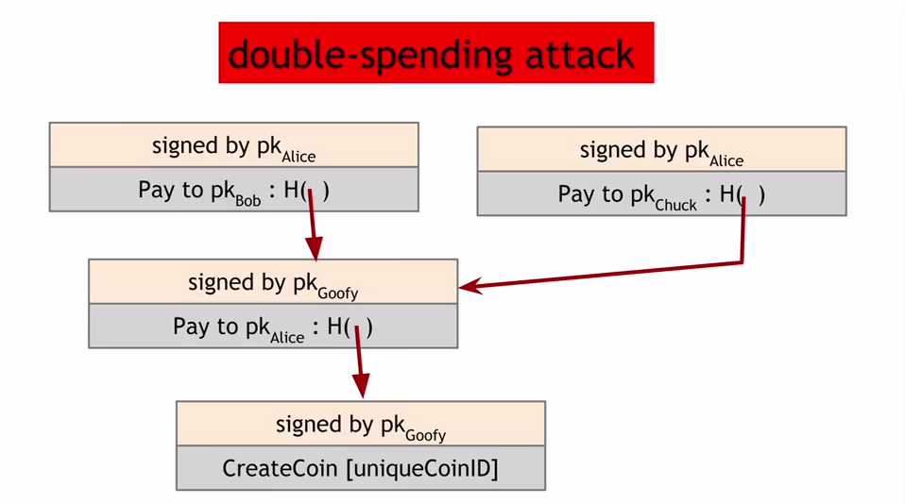

Goofycoin
Goofy creates coins
Goofy transfers to Alice
Alice transfers to Bob
design?

Slide 16
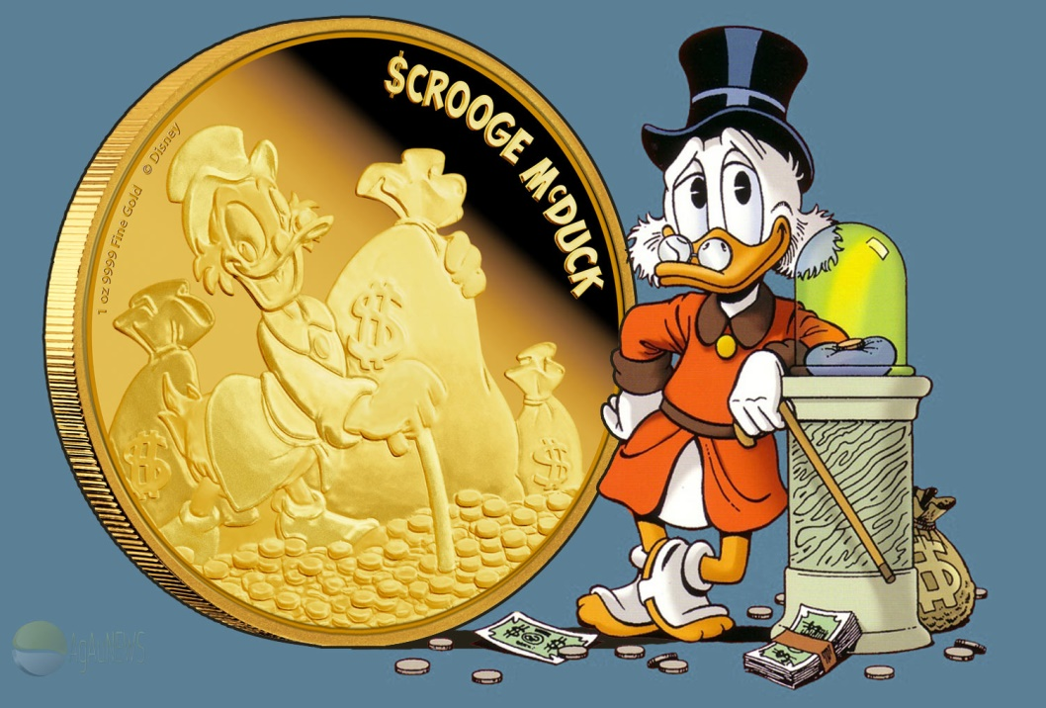
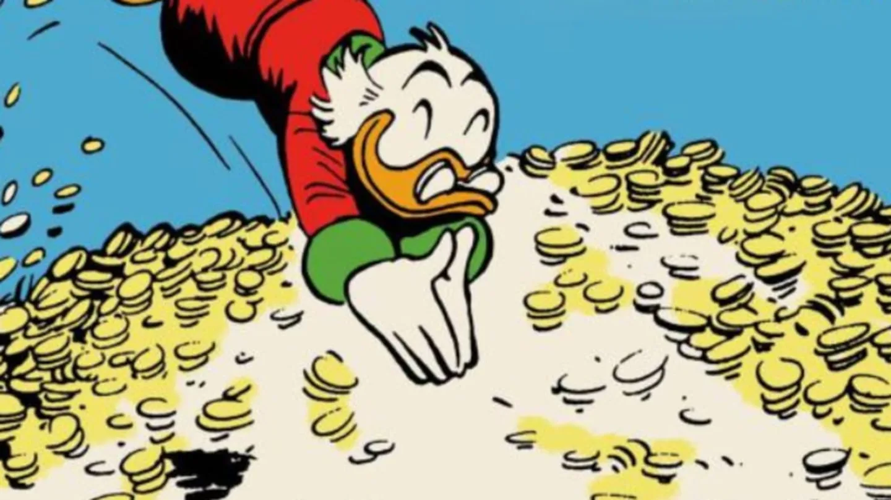
Scroogecoin
Scrooge publishes append-only ledger
block chain
digital signatures
transaction record
Notes:
-all data written in this ledger cannot be deleted
-public record of all transactions – to detect double-spends
-Scrooge digitally signs final hash pointer for block chain regularly

Slide 17
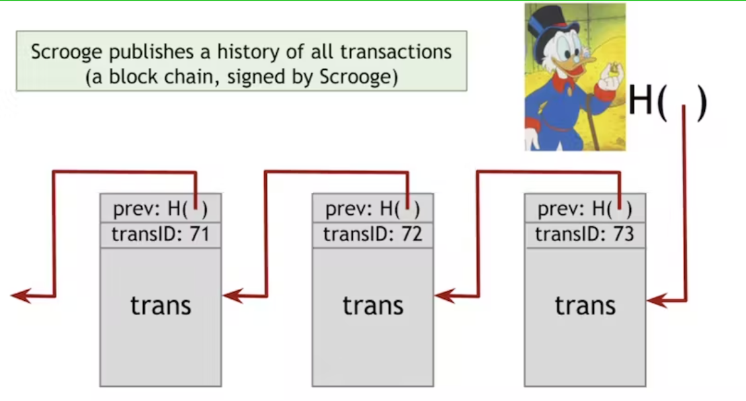
Scroogecoin
Scrooge publishes append-only ledger
block chain
digital signatures
transaction record
double-spends
Notes:
-all data written in this ledger cannot be deleted
-public record of all transactions – to detect double-spends
-Scrooge digitally signs hash pointers for block chain regularly
-one transaction per block (basic case)
-Scrooge ensures no double-spends

Slide 18
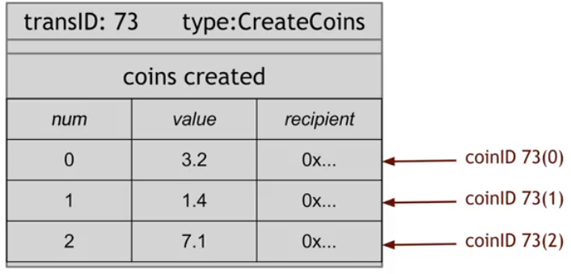
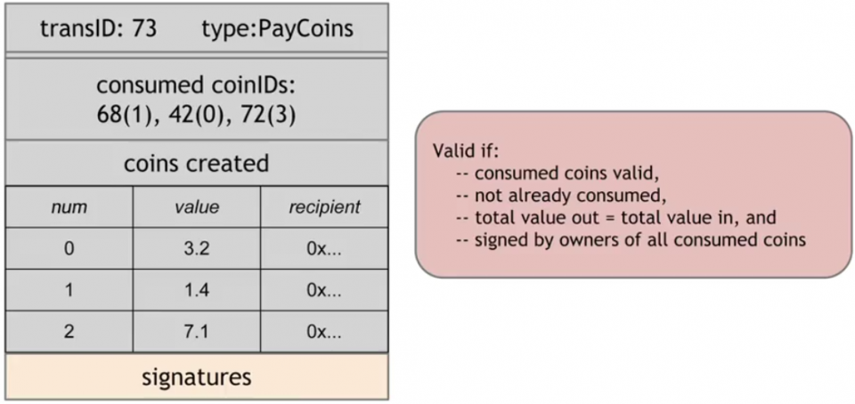
Scroogecoin
CreateCoins transaction
PayCoins transaction
Notes:
-CreateCoins – just like Goofy, except multiple coins are created
- each coin has a unique serial number (CoinID – combination of transaction ID and serial number in transaction) and a recipient
-transaction is always valid if signed by Scrooge
-Scrooge (like Goofy) can create as many coins as he likes
-PayCoins – consumes some coins and creates others of same total value
-everyone who is making a payment (coin being consumed) has to sign this transaction
-4 rules – if followed, Scrooge will accept transaction and write it onto the ledger
-everyone can see which transactions have happened
-double-spending – opportunity is the delay between transactions being circulated and them being published on ledger
-immutability/flexibility – coins are never changed, subdivided, or created
-how to subdivide or combine – Alice could consume one coin and produce new coins of same value which are assigned back to her

Slide 19

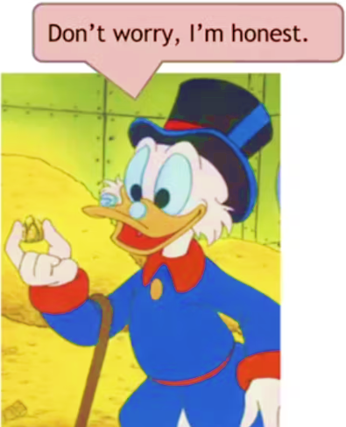
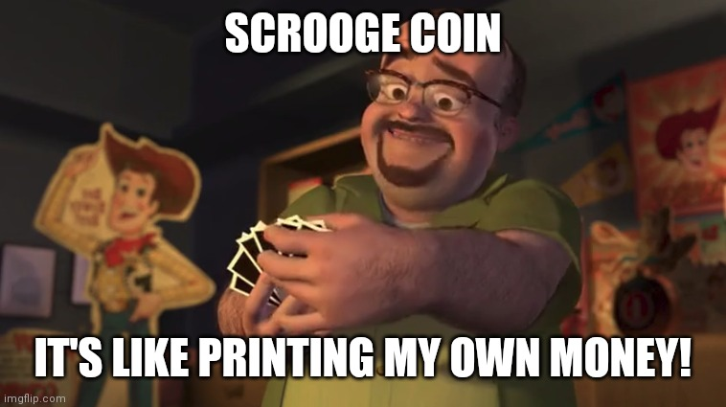
Scroogecoin
monopoly
fake transactions?
censorship
blackmail
money supply
boredom
decentralization
consensus
minting
ledger

Slide 20
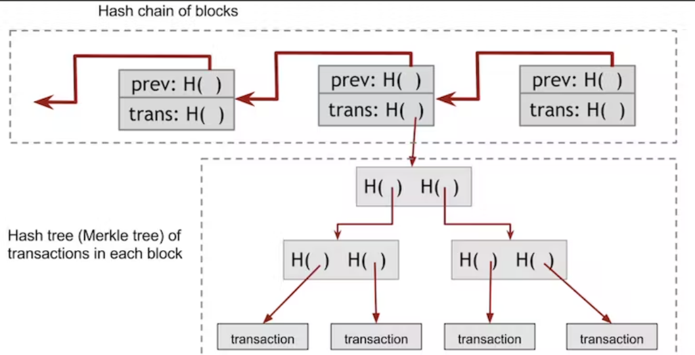
Bitcoin

Slide 21
Homework
Chap 1: Intro to Cryptography and Cryptocurrencies Bitcoin and Cryptocurrency Technologies: A Comprehensive Introduction
Blockchain demo(link) (code)
Merkle Trees (Nakamoto.com) (link)
Public Key Cryptography (Nakamoto.com) (link)
Further reading
The World’s Oldest Blockchain (link)
The Inventor of the Merkle Tree Wants DAOs to Rule the World (link)

Slide 22

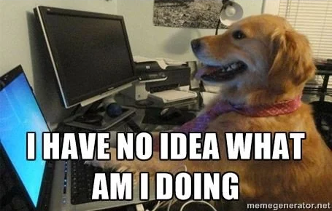
humor

